Slide 1


Pharmacy First Service for UTI

Slide 2
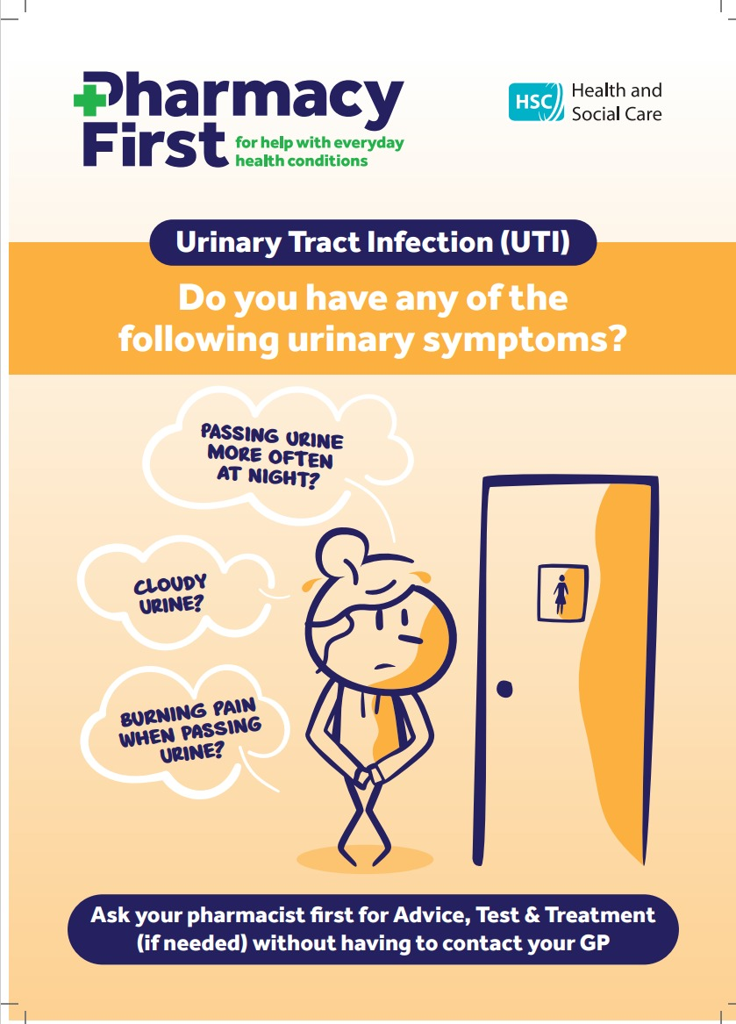

Urinary Tract Infections (UTI)

Slide 3
Contents
Pharmacy First Training Requirements
Eligibility
UTI consultation
  Consent
  Assessing the symptoms
  Diagnosis
  Urine testing
  Supply of medicines
Service documentation
  Consultation form
  Claim form
Remuneration and reimbursement
Service monitoring
Useful resources

Slide 4
UTI Training Requirements
Mandatory Training
Training has been provided by SPPG via ECHO
The training video can be accessed on ECHO Moodle site
Optional Training
The TARGET Antibiotics Toolkit; presentation; a series of interactive webinars developed for Managing Urinary Tract Infections (UTIs)
The TARGET Antibiotics Toolkit training resources available at TARGET tools to train prescribers: TARGET antibiotic toolkit training resources (rcgp.org.uk) which includes a video presentation on UTI https://youtu.be/wLFJtcn5S7g
NICPLD e-learning courses, antimicrobials, Minor Ailments- urogenital
NICE guidance on antimicrobial stewardship and urinary tract infections.

Slide 5
Eligibility
Patient Eligibility
Women aged 16-64 years old who are registered with a GP in Northern Ireland
Not Eligible
Temporary residents
Patients in Care Homes
Pharmacy Eligibility
Must hold a contract with SPPG
Access to secure HSC email
Staff must be trained and competent
SOP in place
PGDs signed
Service must be available during all opening hours where possible
Pharmacist Eligibility
Registered with PSNI
Pharmacist IP registered with PSNI
Working in a pharmacy contracted for service
Competent

Slide 6
Consent
Gain informed consent prior to the consultation
Highlight the privacy notice
Accessing the service
encourage patient to ‘phone first’ and to bring in a urine sample
Face to face appointment
Agree with local GP practices referral process

Slide 7
Diagnosis
Three key diagnostic symptoms:
  Dysuria
  New nocturia
  Cloudy urine
Other symptoms may include
Frequency
Urgency
Haematuria
Suprapubic discomfort
Use dipstick testing:
  ≤1 key diagnostic symptoms must use a dipstick
  ≥2 key diagnostic symptoms does not require a dipstick to confirm diagnosis*
  *It is good practice to consider testing if the symptoms are mild/moderate

Slide 8
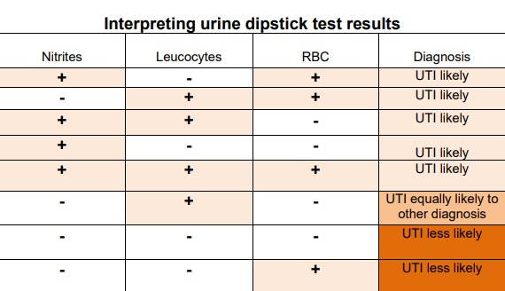
Outcome ‘UTI equally likely to other diagnosis’ consider the time of the specimen (morning is more reliable). Consider antibiotic treatment or refer to GP.
Outcome ‘UTI less likely’ provide self-care advice, target leaflet, consider referral to GP.
Haematuria only: UTI unlikely-refer to GP and note on the consultation record
Haematuria plus other UTI symptoms: Note on record, treat with antibiotics and refer to GP
ALL haematuria should be noted on consultation record and highlighted to GP

Slide 9
Sampling
Provide urine dipstick and sterile specimen bottles.
Mid-stream sample.
Encourage patients to bring sample with them.
Ensure infection prevention and control measures.
Wear gloves for testing and disposal.
Dispose of urine in toilet.
Urine sample container disposed of in general waste.

Slide 10
Treatment
Analgesics
Consider NSAIDs as first-line treatment in women <65 years with mild UTI symptoms.
NSAIDs can be considered as an alternative to antibiotics following risk/benefit discussion with patient with moderate/severe symptoms.
Limit to three days therapy and advise to see GP if symptoms do not resolve or worsen within the three days.
Paracetamol can be used as an option for pain if preferred or more appropriate

Slide 11
Treatment
Self-care
Advise on the use of analgesics for pain relief
Advise to drink fluids to avoid dehydration
Be aware of no evidence on the efficacy of cranberry products or urine alkalinising agents to treat UTI
Provide all patients with safety-netting advice and self-care advice which includes the Target leaflet.

Slide 12
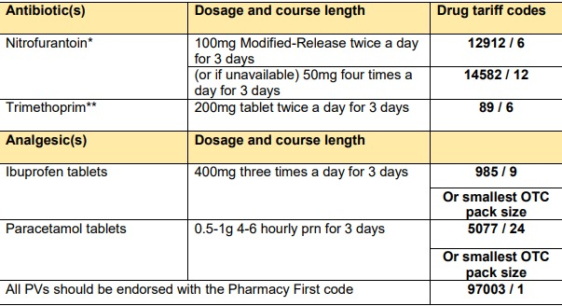
Independent Prescribers
Write a prescription for the medicine in accordance with SOP
Medicines prescribed can be from POM packs
Non-IP Pharmacist
Supply medicine in line with PGD and complete a pharmacy voucher
POM antibiotics should be supplied in line with PGD and analgesics are to be supplied in OTC/P packs
Use the smallest OTC pack size available to be supplied, labelled and coded

Slide 13
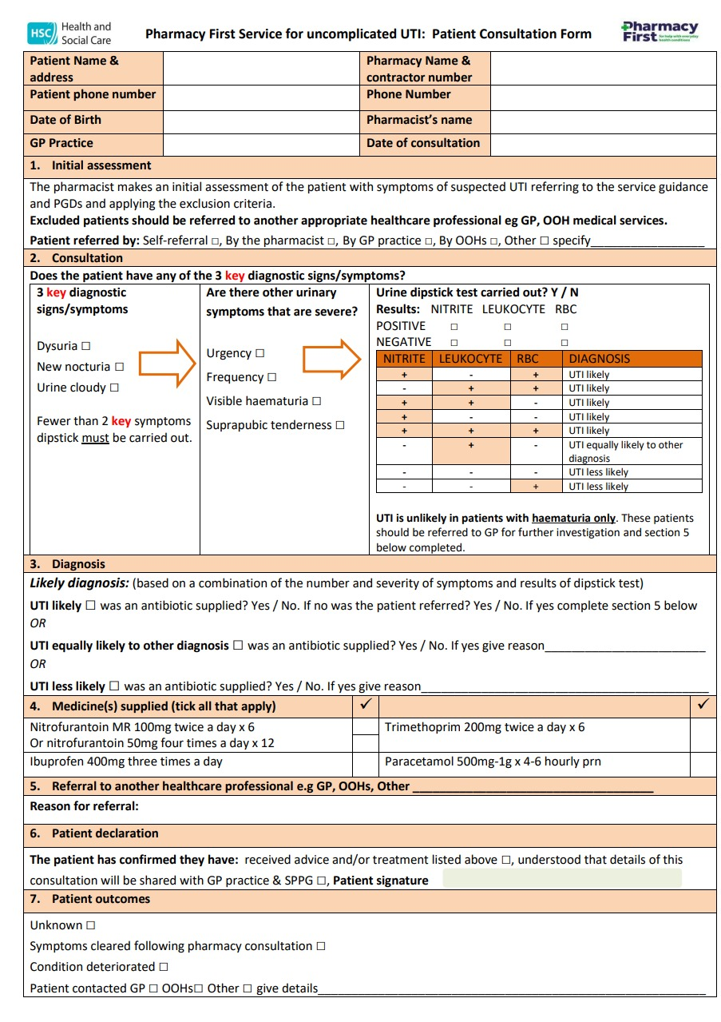
Service Documentation
Consultation Form
The consultation form can be found on the BSO website
Retain the consultation form in the pharmacy and in all cases send a copy to the GP for their records.
IP prescriptions are to be coded using normal DT codes and submitted to BSO in the fully coded bundle.
Pharmacy vouchers are to be coded using normal DT codes and Pharmacy First code 97003/1. Submit PV along with other PF vouchers.
Complete the monthly claim form and email to local integrated care offices for processing and payment

Slide 14
Remuneration and Reimbursement
One off set-up payment of £200 per pharmacy
Consultation fee of £30 per consultation
Reimbursement of the cost of the medicines

Slide 15
Useful Resources
Service Specification
Monthly claim form
Consultation Form
GP Flowchart
Public Health England UTI Diagnostic reference tool
FAQs
Orders for prescription pads and PV1s
PGDs, SOPs, and further resources are available here.

