Slide 1


Pharmacy First Pilot Service for Treatment of Shingles

Slide 2


Shingles

Slide 3
Contents
Training Requirements
Eligibility
Consultation
Formulary
Records
Remuneration and Reimbursement
Useful Resources

Slide 4
Service Training Requirements
Mandatory Training
Training was provided by SPPG via ECHO
  Recorded and available on ECHO Moodle site
Additional Training
NIECR training available here and here.
PGD training available here and here.
Diagnostic and Treatment resources available on service specification.

Slide 5
Eligibility
Pharmacy Eligibility
  Must hold a contract with SPPG
  Staff trained and competent
  SOP in place
  PGDs in place
  Service available during all opening hours
Pharmacist Eligibility
  Registered with PSNI
  IP pharmacists must be registered with PSNI
  Working in a pharmacy contracted to provide the service
  Competent
Patient Eligibility
Patients aged 18 years and over who are registered with a GP in NI
Not eligible
  Temporary residents
  Patients in care homes

Slide 6
Consent
Must gain consent before the consultation
Share privacy notice
Access
Patient to contact pharmacy in person or by phone
Consultation must be in person in the pharmacy
Patients may be referred into the service from GP practice.

Slide 7
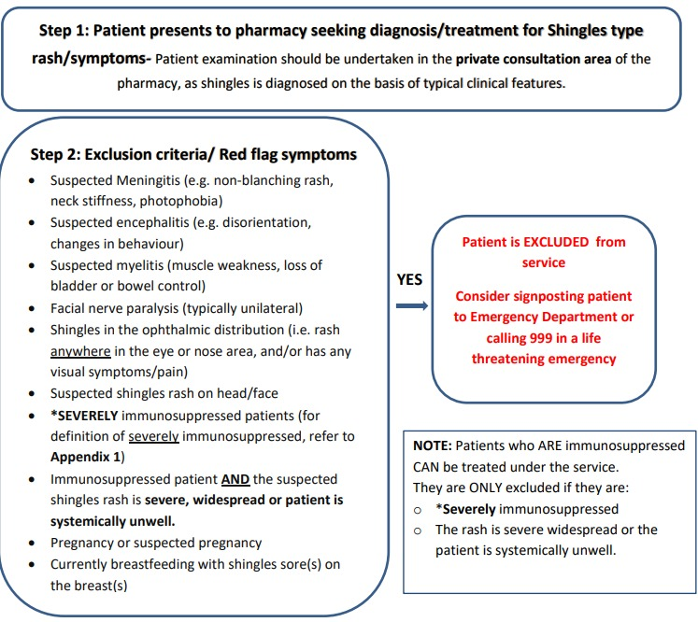
Consultation

Slide 8
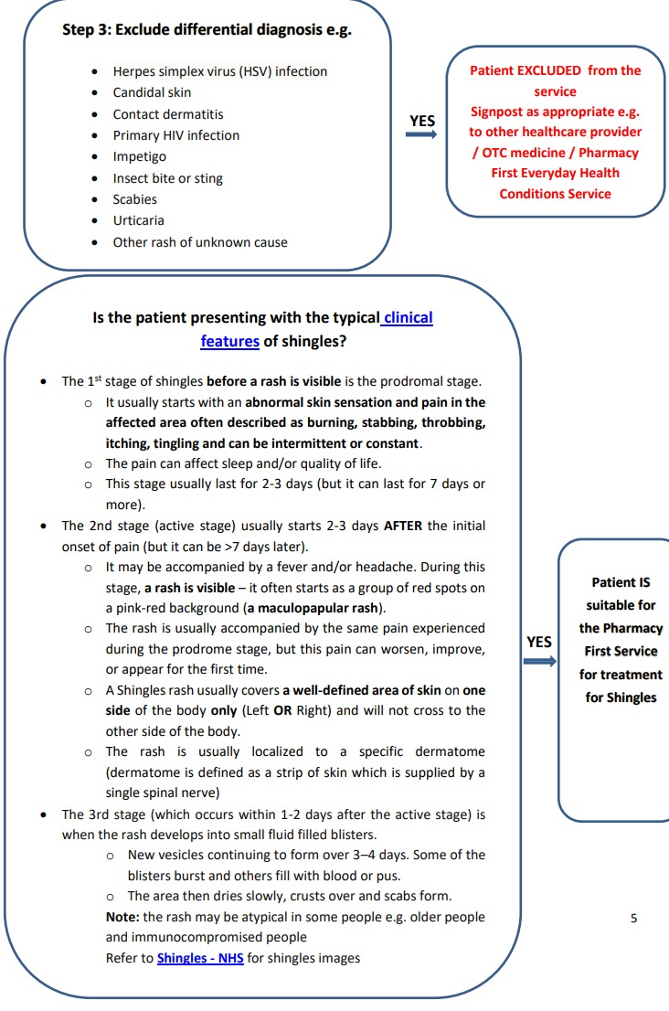
Consultation continued

Slide 9
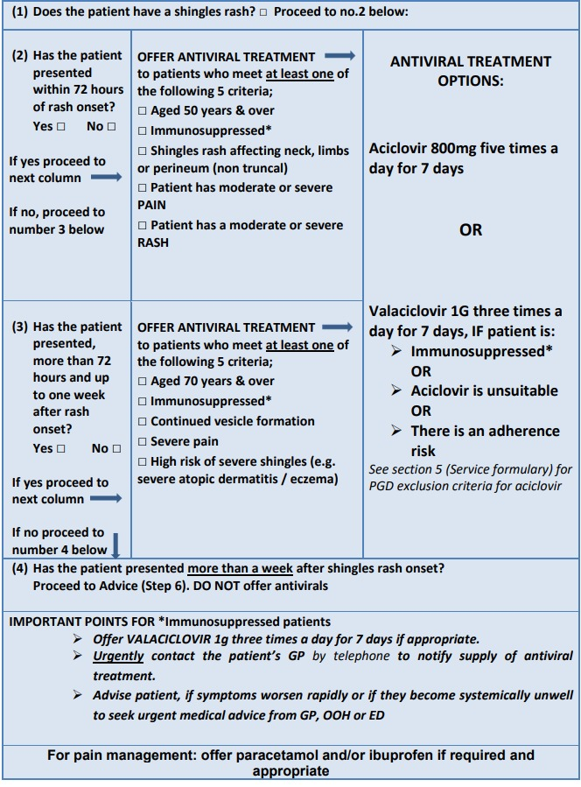
Treatment Options with Shingles Infection

Slide 10
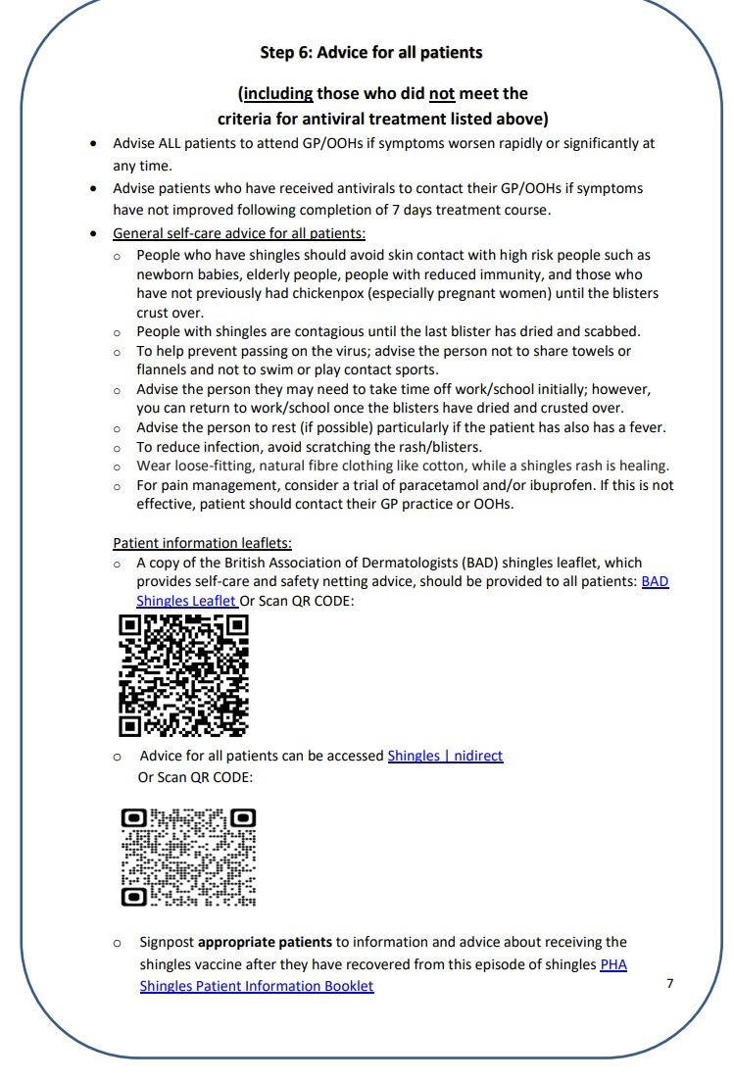
Advice for All Patients

Slide 11
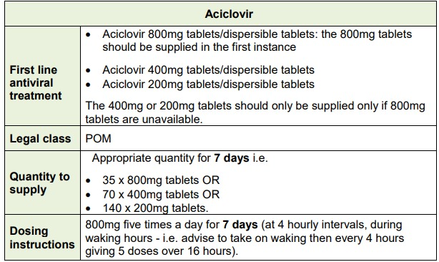
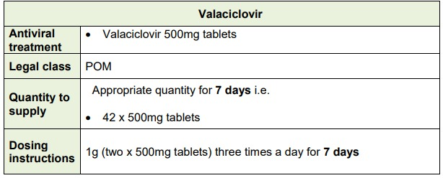
Service Formulary
Exclusion Criteria for Aciclovir
Individuals who:
Require assistance with taking meds and adherence may be an issue
Are already prescribed 8 or mor medicines per day
Immunocompromised
**These patient should be offered Valaciclovir**

Slide 12
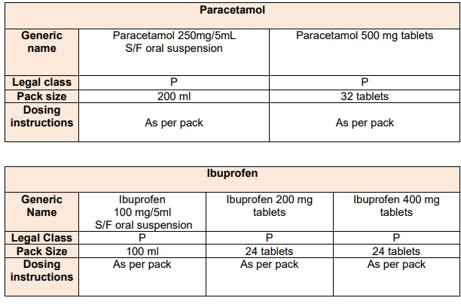
Analgesia

Slide 13
Medicines Supply
Where a pharmacists decides to supply a medicine, they must use the agreed formulary.
The pharmacist may agree to sell a medicine outside of the formulary, and the consultation will still be considered to be within the terms of the service.
Pharmacist Independent Prescribers must only prescribe medicines as listed in the service formulary and may dispense from POM packs
Non-IP Pharmacists can supply POM antivirals in line with the PGDs and analgesics must be supplied from OTC/P packs.

Slide 14
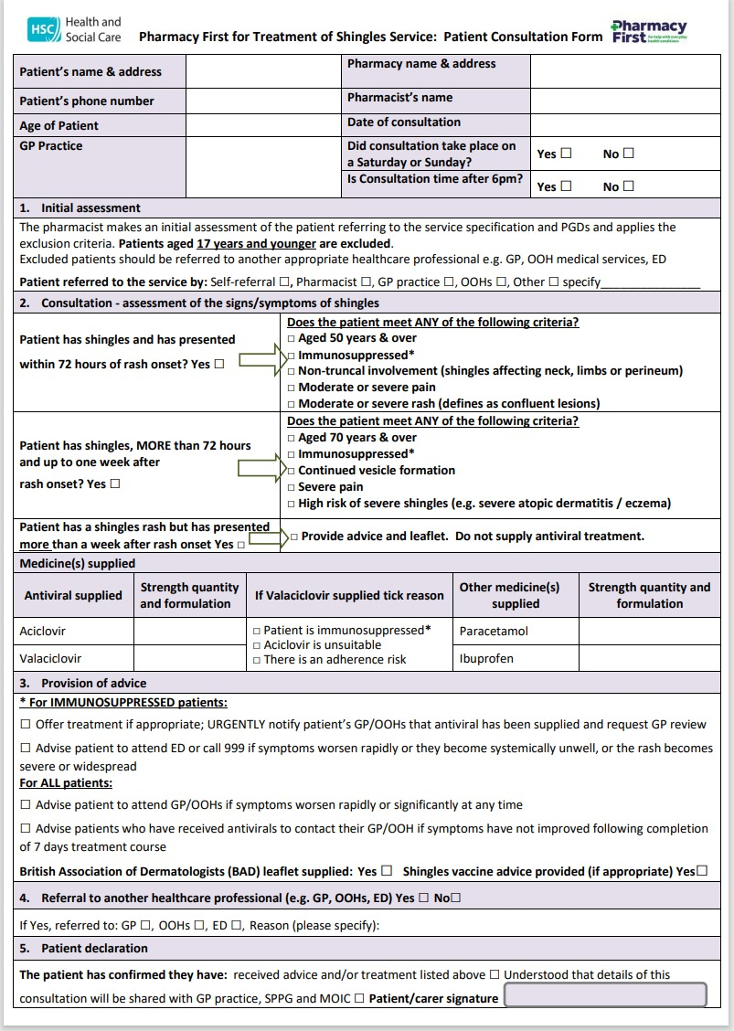
Consultation Form
Consultation form can be found on BSO website.
Transfer a copy to the GP within 24/48 hours.
Contact GP urgently if patient presents with shingles and is immunosuppressed to advise the patient has been assessed and supplied treatment for shingles
Complete a record of all consultations on to the monthly claim form and email to local primary care offices for payment.

Slide 15
Remuneration and Reimbursement
One off service set-up payment of £200 per pharmacy contractor
Consultation fee of £25 per consultation
Cost of medicines will be reimbursed on submission to BSO of the prescriptions or pharmacy vouchers

Slide 16
Useful Resources
Service specification and guidance
Privacy notice
Consultation form
Monthly claim form
Service Contract
SOP template
British Association of Dermatologists Shingles Leaflet
Aciclovir PGD
Valaciclovir PGD
Shingles Green Book Chapter 28a

