Slide 1


Pharmacy First Service For Sore Throat Winter 24/25

Slide 2


Sore Throats

Slide 3
Contents
Training Requirements
Eligibility
Consultation
Throat swab testing
Interpreting swab results
Patient advice
Formulary choices
Records
Remuneration and reimbursement
Useful resources

Slide 4
Sore Throat Training Requirements
Mandatory Training
Training was provided by SPPG via ECHO.
  Recorded and available on ECHO Moodle site
Additional Training
The TARGET Antibiotics Toolkit training resources available at TARGET tools to train prescribers: TARGET antibiotic toolkit training resources (rcgp.org.uk) which includes a video presentation https://youtu.be/wLFJtcn5S7g
• NICE guidance on antimicrobial stewardship, NICE Guideline, NG84. Sore throat (acute) in adults: antimicrobial prescribing and NICE CKS sore throat - acute
• NICPLD online modules Antimicrobial Stewardship.

Slide 5
Eligibility
Pharmacist Eligibility
Registered with PSNI
Working in a pharmacy contracted for service
Competent
Pharmacy Eligibility
Contract
Trained staff
SOP
PGD
Service available during opening hours
Patient Eligibility
Patients aged 5 years and over who are registered with a GP in NI.
Service not available to temporary residents or those in a Care Home

Slide 6
Consent
Gain informed consent before the consultation.
Share privacy notice
Access
Patient contact pharmacy initially by phone or in person
Arrange an appointment
Agree referral process with local GP practices

Slide 7
The Consultation
Assess the patient’s symptoms using the FeverPain score.
FeverPain score is scored out of 5
  Fever in last 24 hours
  Purulent tonsils
  Rapid attendance
  Severely inflamed tonsils
  No cough or coryza

Slide 8
FeverPain Score and RADT
Suitable RADTs must be available for the sore throat consultation.
Other consumables e.g PPE, tongue depressors and thermometers may be required.
Score 0 or 1
Do not offer RADT or antibiotics
Can offer symptom relief and advice
Patient can return to pharmacy if symptoms persist after 7 days
See GP/OOH/ED if patient becomes systemically unwell
Score 2 or 3
Consider carrying out RADT if patient likely to benefit for antibiotic
If unlikely to benefit, offer symptom relief and advice
Score 4 or 5
Carry out RADT

Slide 9
Where can I get throat swabs?
Community pharmacists are free to source any brand of RADT as listed on NICE.
Two of the brands listed on NICE can be sourced locally
  Osom® are available from Alliance wholesaler
  Biopanda reagents stock two types (cassettes and test strips)

Slide 10
How to carry out a throat swab
Please refer to the video via the link below:
How to perform a throat swab on a patient
Useful tip
  Ask the patient to sound out ‘Ahh’

Slide 11
Interpreting RADT results
FeverPain Score 2 or 3 with positive RADT result
FeverPain Score 4 or 5 with positive RADT result
Options Available
  Watch and wait if practical
  Consider supplying antibiotic with advice
If an antibiotic is not supplied in either option, the patient should be advised
  Return to pharmacy for reassessment if no improvement over next 48 hours
  Seek advice GP/OOH/ED if systemically very unwell
  Refer to symptom relief and advice for patients
Consider supplying antibiotic with advice and symptom relief
Advise to seek advice GP/OOH/ED if becomes systemically unwell
If antibiotics are not supplied:
  Advise to return to pharmacy if no improvement over next 48 hours
  Seek advice GP/OOH/ED if systemically unwell
  Provide symptom relief and advice

Slide 12
Interpreting RADT results
FeverPain score 2,3,4 or 5 with a negative RADT
Reassure patient
Safety net
  Return to Pharmacy is no improvement in 48 hours
  Advise to see GP/OOH/ED if systemically unwell
Offer symptom relief and advice.

Slide 13
Patient Advice
Patients must be given advice and leaflet relating to antimicrobial stewardship.
Sore throat and other infections are usually self-limiting.
Symptoms can get better within 7 days.
Discuss antibiotic side effects.
Discuss antimicrobial resistance.
Provide TARGET information leaflet
Antibiotic not supplied: Return to pharmacy after 7 days (48 hours if FeverPain score 2 or more)
Antibiotic supplied: See GP if symptoms worsen/do not improve within 3-5 days
All patients should contact GP/OOH/ED if systemically very unwell

Slide 14
Lifestyle advice
Rest and take simple pain relief
Avoid smoking and smoky environments
If very unwell try to stay at home and avoid contact
Drink plenty of water
Eat cool and soft foods.
Avoid hot drinks
Children can return to school/daycare after fever has resolved, and/or after taking antibiotics for at least 24 hours

Slide 15
Antibiotic Service Formulary
First line antibiotics
  Phenoxymethylpenicillin suitable for all patients without penicillin allergy
Second line antibiotics
  Clarithromycin for penicillin allergy who are NOT pregnant/breastfeeding
  Erythromycin for penicillin allergy AND pregnant/breastfeeding
See service specification/PGDs for dosing instructions and counselling advice.

Slide 16
Analgesia
Paracetamol and/or ibuprofen can be supplied as per instructions
Medicated lozenges can be purchased
Little to no evidence for benzydamine gargles, zinc lozenge, herbal remedies, acupuncture.
Some may find sucking hard sweets, ice cubes or ice lollies provide relief.
Adults can try a warm saline gargle (not suitable for young children)

Slide 17
Supply of Medicines
Non-IP Pharmacist
IP Pharmacist
Supply medicine in line with PGDs and using agreed formulary
Complete Pharmacy Voucher
PVs should be coded with normal DT codes and add 97003/1 code. Submit to BSO along with other PVs.
POM antibiotics supplied in line with service PGD
Analgesics supplied in OTC/P packs
Write a prescription for medicine in accordance with SOP
IP prescriptions should be coded with normal DT code and submit along with usual prescription bundle to BSO
Medicines prescribed in this way can be dispensed from POM packs
Can only prescribe medicines listed in the Pharmacy First service formulary

Slide 18
Premises
All Pharmacy First sore throat consultations must take place in a consultation area.
Consultation area should be where both the patient and pharmacist can sit down together.
Consultation must not be overheard by another person.
Consultation area should be clearly designated and allow equal access to all patients wishing to avail of Pharmacy First Service.

Slide 19
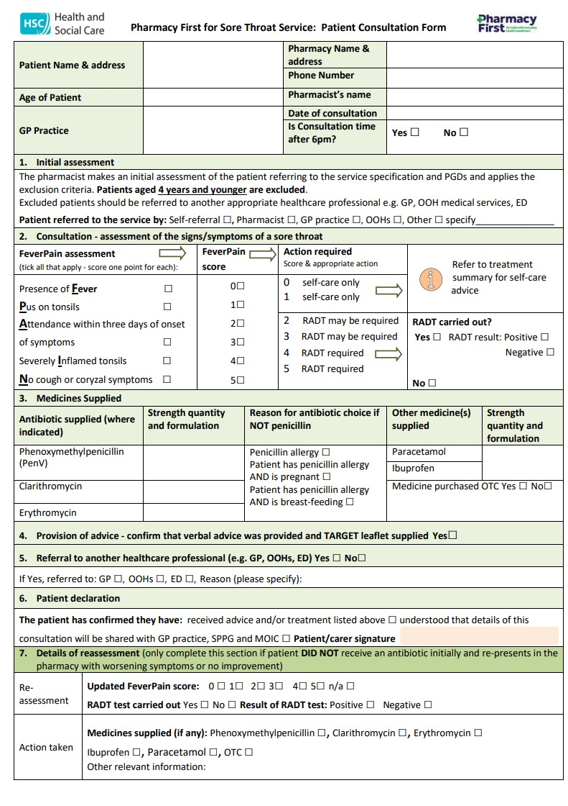
Consultation record
Records must be full, accurate, and contemporaneous.
Where a patient returns for reassessment, fill in section 7.
Retain a record for monitoring and audit purposes.
In all cases, a copy of the consultation form must be transferred to GP within 24/48 hours.

Slide 20
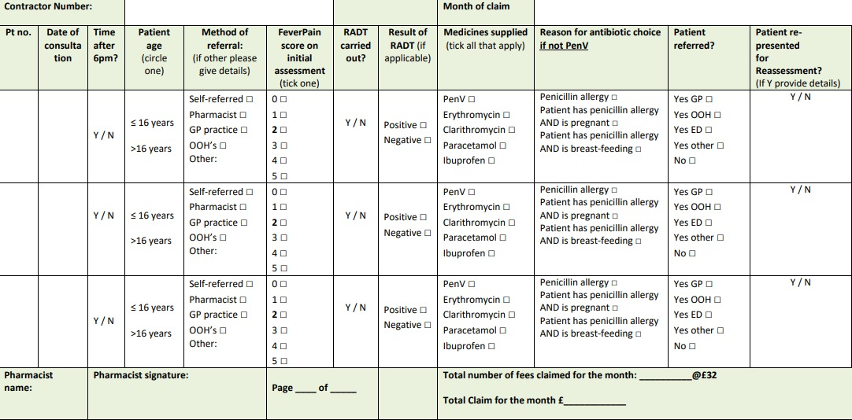
Monthly Claim Form
Available on BSO website
Email to local integrated care office for payment of service fee
Submit in the first week of the month following the consultation

Slide 21
Remuneration and Reimbursement
One-off service set-up payment of £200 per pharmacy contractor
A consultation fee of £32 per consultation. This fee includes the cost of RADTs and other consumables.
Cost of medicine supplied will be reimbursed on submission of prescriptions or pharmacy vouchers to BSO.

Slide 22
Useful links
Service specification and guidance
Privacy notice
Consultation form
Monthly claim form
Service Contract
Summary flow chart for community pharmacy
GP flowchart
Antibiotic decision pathway
Rapid Antigen Detection Tests (RADT)
SOP template (NPA)
Resources for the community pharmacy setting: Overview | RCGP Learning

